Slide 1
Chapter 11 Managing Economies of Scale in the Supply Chain: Cycle Inventory
Supply Chain Management

Slide 2
Role of Inventory in the Supply Chain
Notes:
Notes:

Slide 3
Role of Cycle Inventory in a Supply Chain
Lot, or batch size: quantity that a supply chain stage either produces or orders at a given time
Cycle inventory: average inventory that builds up in the supply chain because a supply chain stage either produces or purchases in lots that are larger than those demanded by the customer
Q = lot or batch size of an order
D = demand per unit time
Cycle inventory = Q/2 (depends directly on lot size)
Average flow time = Avg inventory / Avg flow rate
Average flow time from cycle inventory = Q/(2D)

Slide 4
Graphical Representation
Assume Constant Demand
Inventory (I(t))
slope = -D
Q
T
Time (t)
Time between orders
Instantaneous
Replenishment

Slide 5
Role of Cycle Inventory in a Supply Chain
Q = 1000 units
D = 100 units/day
Cycle inventory = Q/2 = 1000/2 = 500 = Avg inventory level from cycle inventory
Avg flow time = Q/2D = 1000/(2)(100) = 5 days
Flow time is often referred to as days of supply (DOS)
Cycle inventory adds 5 days to the time a unit spends in the supply chain
Lower cycle inventory is better because:
Average flow time is lower
Working capital requirements are lower
Lower inventory holding costs

Slide 6
Role of Cycle Inventory in a Supply Chain
Cycle inventory is held primarily to take advantage of economies of scale in the supply chain
Supply chain costs influencing lot size:
Material cost = C
Fixed ordering cost = S
Holding cost = H = hC (h = cost of holding $1 in inventory for one year)
Primary role of cycle inventory is to allow different stages to purchase product in lot sizes that minimize the sum of material, ordering, and holding costs
Ideally, cycle inventory decisions should consider costs across the entire supply chain
In practice, each stage generally makes its own supply chain decisions – increasing total cycle inventory and total costs in the supply chain

Slide 7
Role of Cycle Inventory in a Supply Chain
Economies of scale exploited in three typical situations…
A fixed cost is incurred each time an order is placed or produced
The supplier offers price discounts based on the quantity purchased per lot
The supplier offers short-term price discounts or holds trade promotions

Slide 8
Relevant Costs
Holding Costs - Costs proportional to the quantity of inventory held. Includes:
Physical Cost of Space (3%)
Taxes and Insurance (2 %)
Breakage, Spoilage, and Deterioration (1%)
Opportunity Cost of alternative investment. (18%)
(Total: 24%)
Order cost
Buyer time
Transportation costs
Receiving costs
Other costs

Slide 9
Estimating Cycle Inventory Related Costs in Practice
Inventory Holding Cost
Weighted-Average Cost of Capital (WACC)
where
E = amount of equity
D = amount of debt
R_{f} = risk-free rate of return (return on US Treasuries)
β = the firm’s beta (risk multiple / ex. source: Bloomberg)
MRP = market risk premium (investor-driven return on equity above R_{f})
R_{b} = rate at which the firm can borrow money
t = tax rate

Slide 10
Estimating Cycle Inventory Related Costs in Practice
Penalty or Shortage Costs. All costs that accrue when insufficient stock is available to meet demand. These include:
Loss of revenue for lost demand
Costs of bookkeeping for backordered demands
Loss of goodwill for being unable to satisfy demands when they occur.
Generally assume cost is proportional to number of units of excess demand.

Slide 11
Economies of Scale to Exploit Fixed Costs
Annual demand = D
Number of orders per year = D/Q
Annual material cost = (C)(D)
Annual order cost = (D/Q)S
Annual holding cost = (Q/2)H = (Q/2)hC
Total annual cost = TC = CD + (D/Q)S + (Q/2)hC

Slide 12
Cost Relationships
TC(Q)
C(Q)
HQ/2
(inventory)
SD/Q
order
Q* = EOQ
Q

Slide 13
Fixed Costs: Optimal Lot Size and Reorder Interval (EOQ)
D: Annual demand
S: Setup or Order Cost
C: Cost per unit
h: Holding cost per year as a fraction of product cost
H: Holding cost per unit per year
Q: Lot Size
T: Reorder interval
n: Reorder frequency
Material cost is constant and therefore is not considered in this model
Notes:
Notes:

Slide 14
Example
Demand, D = 12,000 computers per year
d = 1000 computers/month
Unit cost, C = $500
Holding cost fraction, h = 0.2
Fixed cost, S = $4,000/order
Q* = Sqrt[(2)(12000)(4000)/(0.2)(500)] = 980 computers
Cycle inventory = Q/2 = 490
Flow time = Q/2d = 980/(2)(1000) = 0.49 month
Reorder interval, T = 0.98 month
Notes:
Notes:

Slide 15
Example (continued)
Annual ordering and holding cost =
(12000/980)(4000) + (980/2)(0.2)(500) = $97,980
Suppose lot size is reduced to Q=200, which would reduce flow time:
Annual ordering and holding cost =
(12000/200)(4000) + (200/2)(0.2)(500) = $250,000
To make it economically feasible to reduce lot size, the fixed cost associated with each lot would have to be reduced

Slide 16
Example
If desired lot size = Q* = 200 units, what would S have to be?
D = 12000 units
C = $500
h = 0.2
Use EOQ equation and solve for S:
S = [hC(Q*)²]/2D = [(0.2)(500)(200)²]/(2)(12000) = $166.67
To reduce optimal lot size by a factor of k, the fixed order cost must be reduced by a factor of k²

Slide 17
Sensitivity to Q
Suppose we set Q = 1,100…what is new cost?
EOQ cost function is relatively flat around its minimum
Often better to order a convenient lot size close to Q* than Q* itself
0.67% increase!

Slide 18
EOQ Model
Total Cost is not particularly sensitive to the optimal order quantity
Q=1.10EOQ
TC(Q)=1.0045*TC(EOQ)

Slide 19
Production Lot Sizing
The entire lot does not arrive at the same time
Production occurs at a specified rate P
Inventory builds up at a rate of P – D
Annual setup cost
Annual holding cost

Slide 20
Aggregating Multiple Products in a Single Order
Transportation is a significant contributor to the fixed cost per order
Can possibly combine shipments of different products from the same supplier
same overall fixed cost
shared over more than one product
effective fixed cost is reduced for each product
lot size for each product can be reduced
Can also have a single delivery coming from multiple suppliers or a single truck delivering to multiple retailers
Receiving and loading costs reduced

Slide 21
Example: Aggregating Multiple Products in a Single Order
Suppose there are 4 computer products : Deskpro, Litepro, Medpro, and Heavpro
Assume demand for each is 1000 units per month
The computers are valued equally
If each product is ordered separately:
Q* = 980 units for each product
Total cycle inventory = 4(Q/2) = (4)(980)/2 = 1960 units
Aggregate orders of all four products:
Combined Q* = 1960 units
For each product: Q* = 1960/4 = 490
Cycle inventory for each product is reduced to 490/2 = 245
Total cycle inventory = 1960/2 = 980 units
Average flow time, inventory holding costs will be reduced

Slide 22
Lot Sizing with Multiple Products or Customers
In practice, the fixed ordering cost is dependent at least in part on the variety associated with an order of multiple models
A portion of the cost is related to transportation (independent of variety)
A portion of the cost is related to loading and receiving (not independent of variety)
Three scenarios:
Lots are ordered and delivered independently for each product
Lots are ordered and delivered jointly for all three models
Lots are ordered and delivered jointly for a selected subset of models

Slide 23
Lot Sizing with Multiple Products
D_{i}: Annual demand for product i
S: Order cost incurred each time an order is placed, independent of the variety of products in the order
s_{i}: Additional order cost incurred if product i is included in the order
Demand per year Litepro, Medpro, and Heavpro
D_{L} = 12,000; D_{M} = 1,200; D_{H} = 120
Common transportation cost, S = $4,000
Product specific order cost
s_{L} = $1,000; s_{M} = $1,000; s_{H} = $1,000
Holding cost factor, h = 0.2
Unit cost
C_{L} = $500; C_{M} = $500; C_{H} = $500
Notes:
Notes:

Slide 24
Multiple Products Ordered and Delivered Independently
 | Litepro | Medpro | Heavypro
Demand per year | 12,000 | 1,200 | 120
Fixed cost/order | $5,000 | $5,000 | $5,000
Optimal order size | 1,095 | 346 | 110
Cycle inventory | 548 | 173 | 55
Annual holding cost | $54,772 | $17,321 | $5,477
Order frequency | 11.0/year | 3.5/year | 1.1/year
Annual ordering cost | $54,772 | $17,321 | $5,477
Average flow time | 2.4 weeks | 7.5 weeks | 23.7 weeks
Annual cost | $109,544 | $34,642 | $10,954
Table 11-1
Total annual cost = $155,140
Notes:
Notes:

Slide 25
Lots Ordered and Delivered Jointly

Slide 26
Products Ordered and Delivered Jointly
Q_{L} = D_{L}/n* = 12000/9.75 = 1230
Q_{M} = D_{M}/n* = 1200/9.75 = 123
Q_{H} = D_{H}/n* = 120/9.75 = 12.3
Annual order cost = 9.75 x 7,000 = $68,250
Annual ordering
and holding cost = $61,512 + $6,151 + $615 + $68,250
= $136,528

Slide 27
Approach 3: Not Every Product in Every Order
Approach 2 solution:
Heavypro ordered in small batches
If ordered in every 4th order:
Save $9,750 x (3/4) = $7,312.50 in order cost
Add $1,846.20 in holding cost
 | Litepro | Medpro | Heavypro
Demand per year (D) | 12,000 | 1,200 | 120
Order frequency (n∗) | 9.75/year | 9.75/year | 9.75/year
Optimal order size (D/n∗) | 1,230 | 123 | 12.3
Cycle inventory | 615 | 61.5 | 6.15
Annual holding cost | $61,512 | $6,151 | $615
Average flow time | 2.67 weeks | 2.67 weeks | 2.67 weeks

Slide 28
Lots Ordered and Delivered Jointly for a Selected Subset
1
2
3
4
T
2T
3T
4T
Replenishment includes a subset of a family of n items every T time periods

Slide 29
Lots Ordered and Delivered Jointly for a Selected Subset
Step 1: Identify the most frequently ordered product assuming each product is ordered independently
Step 2: For all products i ≠ i*, evaluate the ordering frequency

Slide 30
Lots Ordered and Delivered Jointly for a Selected Subset
Step 3: For all i ≠ i*, evaluate the frequency of product i relative to the most frequently ordered product i* to be m_{i}
Step 4: Recalculate the ordering frequency of the most frequently ordered product i* to be n

Slide 31
Lots Ordered and Delivered Jointly for a Selected Subset
Model Elements
S = “major” order cost independent of variety of items
s_{i} = setup cost for including item i in order
m_{i} = number of replenishment intervals, T , of demand that order quantity, Q_{i} , will satisfy
Q_{i} = D_{i}m_{i}T

Slide 32
Lots Ordered and Delivered Jointly for a Selected Subset
Substituting T* back into TRC :
Now need to find optimal values for m_{j} :

Slide 33
Lots Ordered and Delivered Jointly for a Selected Subset
Note…
Thus…

Slide 34
Lots Ordered and Delivered Jointly for a Selected Subset
Step 5: Evaluate an order frequency of n_{i} = n/m_{i} and the total cost of such an ordering policy
Tailored aggregation – higher-demand products ordered more frequently and lower-demand products ordered less frequently

Slide 35
Lots Ordered and Delivered Jointly for a Selected Subset
Example: S=$50 h=$.3/$/yr
item 2 is “B” and m_{B}=1
i | s_{i} | D_{i}/yr | C_{i} | s_{i}/D_{i}C_{i}
1 | 20 | 6000 | 3 | 20/(6000)(3)=.00111
2 | 25 | 2000 | 22 | 25/(2000)(22)=.00057
3 | 35 | 1000 | 4 | 35/(1000)(4)=.00875

Slide 36
Lots Ordered and Delivered Jointly for a Selected Subset
Base Replenishment Cycle
Order Quantities

Slide 37
Lots Ordered and Delivered Jointly for a Selected Subset
Total Relevant Cost

Slide 38
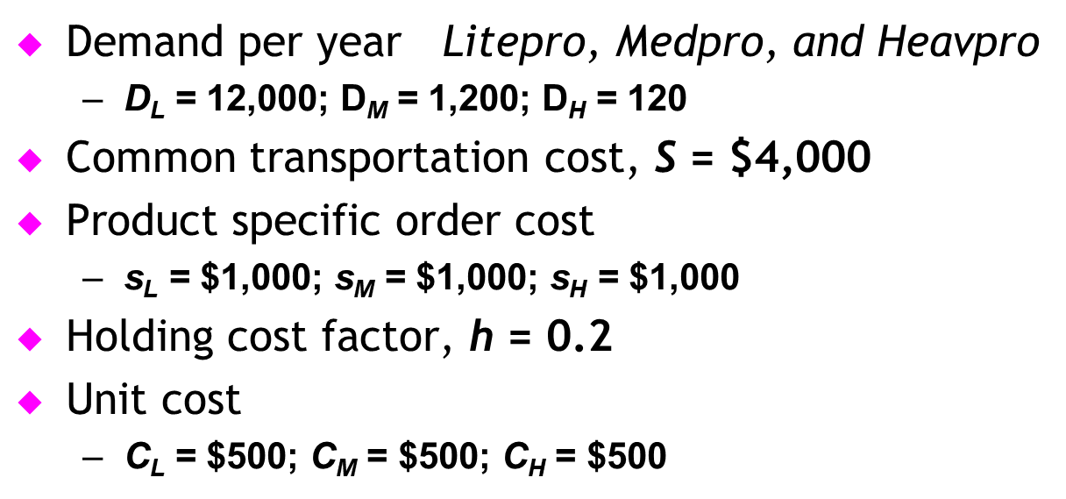
Returning to Computer Products Example…
Applying Step 1
Thus

Slide 39
Ordered and Delivered Jointly – Frequency Varies by Order
Applying Step 2
Applying Step 3

Slide 40
Ordered and Delivered Jointly – Frequency Varies by Order
Applying Step 4
Applying Step 5
Annual order cost Total annual cost
$130,767

Slide 41
Ordered and Delivered Jointly – Frequency Varies by Order
 | Litepro | Medpro | Heavypro
Demand per year (D) | 12,000 | 1,200 | 120
Order frequency (n∗) | 11.47/year | 5.74/year | 2.29/year
Optimal order size (D/n∗) | 1,046 | 209 | 52
Cycle inventory | 523 | 104.5 | 26
Annual holding cost | $52,307 | $10,461 | $2,615
Average flow time | 2.27 weeks | 4.53 weeks | 11.35 weeks
Table 11-3

Slide 42
Lessons from Aggregation
Aggregation allows firm to lower lot size without increasing cost
Complete aggregation is effective if product specific fixed cost is a small fraction of joint fixed cost
Tailored aggregation is effective if product specific fixed cost is a large fraction of joint fixed cost

Slide 43
Aggregation with Capacity Constraint
W.W. Grainger example
Demand per product, D_{i} = 10,000
Holding cost, h = 0.2
Unit cost per product, C_{i} = $50
Common order cost, S = $500
Supplier-specific order cost, s_{i} = $100
Notes:
Notes:

Slide 44
Aggregation with Capacity Constraint
Annual holding cost per supplier
Notes:
Notes:

Slide 45
Aggregation with Capacity Constraint
Total required capacity per truck = 4 x 671 = 2,684 units
Truck capacity = 2,500 units
Order quantity from each supplier = 2,500/4 = 625
Order frequency increased to 10,000/625 = 16
Annual order cost per supplier increases to $3,600
Annual holding cost per supplier decreases to $3,125.
Notes:
Notes:

Slide 46
Economies of Scale to Exploit Quantity Discounts
Lot size-based discount – discounts based on quantity ordered in a single lot
Volume based discount – discount is based on total quantity purchased over a given period
Two common schemes
All-unit quantity discounts
Marginal unit quantity discount (multi-block tariffs)
Why quantity discounts?
Coordination in the supply chain
Price discrimination to maximize supplier profits

Slide 47
Why Quantity Discounts?
Quantity discounts can increase the supply chain surplus for the following two main reasons
Improved coordination to increase total supply chain profits
Extraction of surplus through price discrimination
Price discrimination: firm charges different prices to different customers
Quantity discounts are a form of price discrimination
Suppose P&G charges same price for Cascade to retailers and customers
Customers are willing to pay higher price for the convenience of buying in small quantities
High price => retailers won’t buy
Low price => charging customers less than could have
Quantity discounts can help extract this “surplus”
Notes:
Notes:

Slide 48
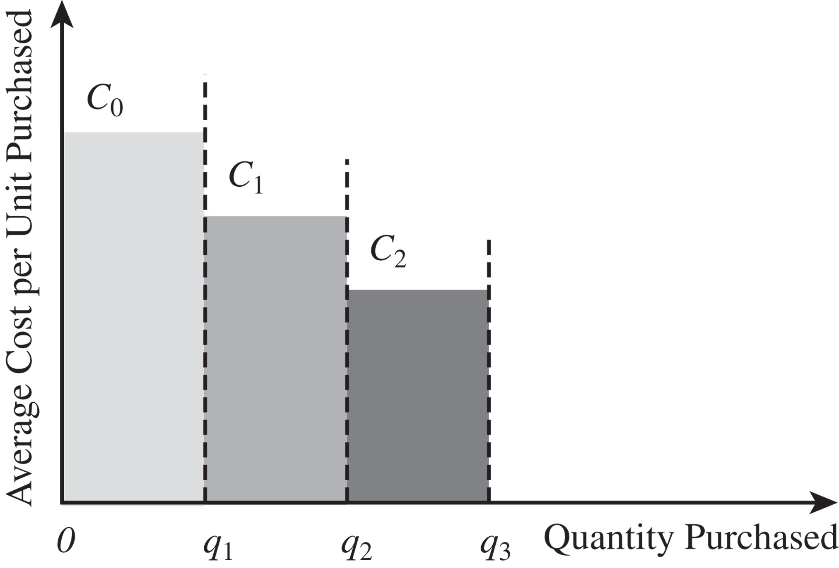
All-Unit Quantity Discounts
Pricing schedule has specified quantity break points q₀, q₁, …, q_{r}, where q₀ = 0
If an order is placed that is at least as large as q_{i} but smaller than q_{i+1}, then each unit has an average unit cost of C_{i}
The unit cost generally decreases as the quantity increases, i.e., C₀>C₁>…>C_{r}
The objective for the company (a retailer in our example) is to decide on a lot size that will minimize the sum of material, order, and holding costs

Slide 49
Total Material Cost
Total Material Cost
C₂
q₂C₁
q₂C₂
q₁C₀
C₁
q₁C₁
C₀
Q
q₀
q₁
q₂

Slide 50
Total Cost
TC(Q)
TC₀(Q)
TC₁(Q)
TC₂(Q)
Q*₀
Q*₁
Q*₂
Q
q₀
q₁
q₂

Slide 51
“Modified” All-Unit Discounts
Total Material Cost
Q
100
200

Slide 52
All-Unit Quantity Discounts
Step 1: Evaluate the optimal lot size for each price C_{i},0 ≤ i ≤ r as follows

Slide 53
All-Unit Quantity Discounts
Step 2: Modify order quantities to account for breakpoints:
1.
2.
3.
=> Q*_{i} = Q_{i}
=> best we can do within break is Q*_{i} = q_{i}
=> ignore (Q_{i+1} will be better)
TC(Q)
TC₀(Q)
TC₁(Q)
TC₂(Q)
Q*₀
Q
Q*₁
Q*₂
q₀
q₁
q₂

Slide 54
All-Unit Quantity Discounts
Step 3: Calculate the total annual cost of ordering Q*_{i} units
Step 4: Select Q*_{i} with the lowest total cost TC_{i}
Cutoff price = price above which an
optimal solution can not occur :

Slide 55
All-Unit Quantity Discount: Example
Order quantity Unit Price
0-4999 $3.00
5000-9999 $2.96
Over 10000 $2.92
q₀ = 0, q₁ = 5000, q₂ = 10000
C₀ = $3.00, C₁ = $2.96, C₂ = $2.92
D = 120000 units/year, S = $100/lot, h = 0.2
Cost/Unit
$3
$2.96
$2.92
5,000
10,000
Order Quantity
Total Material Cost
5,000
10,000
Order Quantity

Slide 56
All-Unit Quantity Discount: Example
Step 1: Calculate Q₂* = Sqrt[(2DS)/hC₂]
= Sqrt[(2)(120000)(100)/(0.2)(2.92)] = 6410
Not feasible (6410 < 10000)
Calculate TC₂ using C₂ = $2.92 and q2 = 10000
TC₂ = (120000/10000)(100)+(10000/2)(0.2)(2.92) +(120000)(2.92)
= $354,520
Step 2: Calculate Q₁* = Sqrt[(2DS)/hC₁]
=Sqrt[(2)(120000)(100)/(0.2)(2.96)] = 6367
Feasible (5000≤6367≤9999) ----- Stop
TC₁ = (120000/6367)(100)+(6367/2)(0.2)(2.96) +(120000)(2.96)
= $358,969
TC₂ < TC₁ → The optimal order quantity Q* is q2 = 10000

Slide 57
All-Unit Quantity Discounts
Suppose fixed order cost were reduced to $4
Without discount, Q* would be reduced to 1265 units
With discount, optimal lot size would still be 10000 units
What is the effect of such a discount schedule?
Retailers are encouraged to increase the size of their orders
Average inventory (cycle inventory) in the supply chain is increased
Average flow time is increased
Is an all-unit quantity discount an advantage in the supply chain?

Slide 58
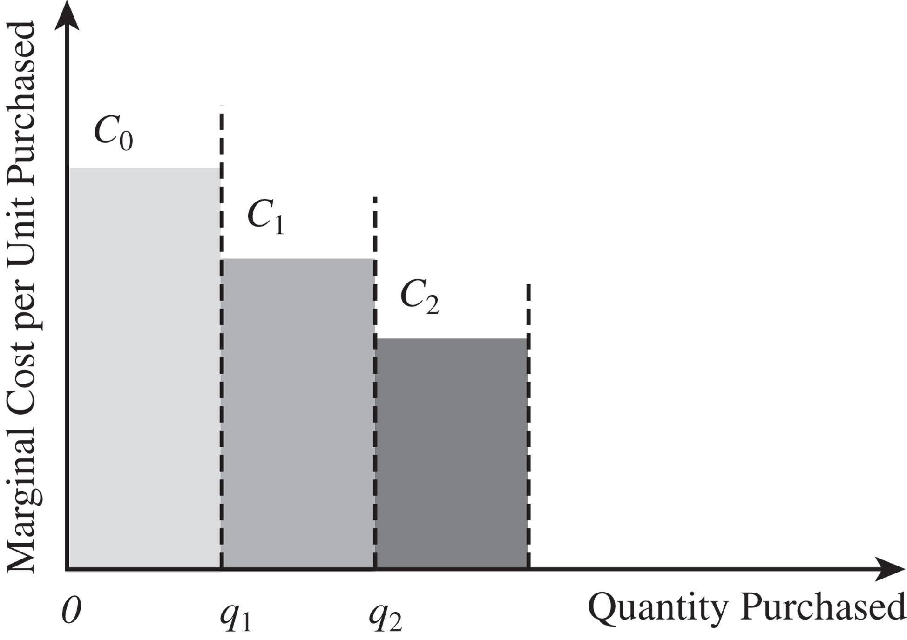
Marginal Unit Quantity Discounts
Multi-block tariffs – the marginal cost of a unit that decreases at a breakpoint
For each value of i, 0 ≤ i ≤ r, let V_{i} be the cost of ordering q_{i} units
Figure 11-4

Slide 59
Total Material Cost
Total Material Cost
C₂
V₂ = C₀(q₁ – q₀) + C₁(q₂ – q₁)
C₁
V₁ = C₀(q₁ – q₀)
C₀
V₀ = 0
Q
q₀
q₁
q₂
V_{i} = material cost of ordering q_{i} units:

Slide 60
Marginal Unit Quantity Discounts
Suppose q_{i} ≤ Q < q_{i+1}
Material cost of each order Q is V_{i} + (Q – q_{i})C_{i}
Total annual cost

Slide 61
Total Annual Cost…
EOQ cost function with S replaced by S + V_{i} + (Q – q_{i})C_{i}
constant
TC(Q)
TC₀(Q)
TC₁(Q)
TC₂(Q)
Q*₀
Q*₁
Q*₂
Q
q₀
q₁
q₂

Slide 62
Marginal Unit Quantity Discounts
Step 1: Evaluate the optimal lot size for each price C_{i}
Step 2: Select the order quantity Q_{i}* for each price C_{i}
TC(Q)
1.
2.
3.
TC₀(Q)
TC₁(Q)
TC₂(Q)
Q*₀
Q*₁
Q*₂
Q
q₀
q₁
q₂

Slide 63
Marginal Unit Quantity Discounts
Step 3: Calculate the total annual cost of ordering Q_{i}*
Step 4: Select the order size Q_{i}* with the lowest total cost TC_{i}

Slide 64
Marginal Unit Quantity Discount Example
Original data now a marginal discount
Order Quantity | Unit Price
0–4,999 | $3.00
5,000–9,999 | $2.96
10,000 or more | $2.92
q₀ = 0, q₁ = 5,000, q₂ = 10,000
C₀ = $3.00, C₁ = $2.96, C₂ = $2.92
D = 120,000/year, S = $100/lot, h = 0.2

Slide 65
Marginal Unit Quantity Discount Example
Step 1

Slide 66
Marginal Unit Quantity Discount Example
Step 2
Step 3

Slide 67
Two “Players”: Manufacturer & Retailer
Retailer buys from manufacturer
One player/stage at each echelon
Retailer costs:
Fixed cost S_{R}
Holding costs h_{R}C_{R}
Manufacturer costs:
Fixed cost S_{M}
Holding costs h_{M}C_{M}
Retailer’s choice of Q affects both players’ costs, but retailer chooses it only based on its costs

Slide 68
Coordination for Commodity Products
For commodity products for which price is set by the market, manufacturers with large fixed costs per lot can use lot-size-based quantity discounts to maximize total supply chain profits.
Lot-size-based discounts, however, increase cycle inventory in the supply chain.

Slide 69
Coordination for Commodity Products
Market sets price… act to reduce costs
D = 120,000 bottles/year
S_{R} = $100, h_{R} = 0.2, C_{R} = $3
S_{M} = $250, h_{M} = 0.2, C_{M} = $2
Retailer’s optimal lot size = 6,324 bottles
Retailer cost =TC(Q*)= $3,795; Supplier cost at Q* = $6,009
Supply chain cost = $9,804
Notes:
Notes:

Slide 70
Coordination for Commodity Products
What can the manufacturer do to decrease supply chain costs?
Coordinated lot size:
Retailer cost = $4,059 … was $3795 !!
Supplier cost = $5,106;
Supply chain cost = $9,165
S
C
Notes:
Notes:

Slide 71
Designing a Suitable Lot Size-Based Quantity Discount
Manufacturer needs to get Drugs Online (DO) to increase its lot size to 9,165
Quantity discount is one way to do this
(We’ll assume all-unit)
Design a suitable quantity discount that gets DO to order in lots of 9,165 units when it aims to minimize only its own total costs
Manufacturer needs to offer an incentive of at least $264 per year ($4095-$3795) to DO in terms of decreased material cost if DO orders in lots of 9,165 units
Appropriate quantity discount is $3 if DO orders in lots smaller than 9,165 units and $2.9978 for orders of 9,165 or more
Notes:
Notes:

Slide 72
Coordination for Commodity Products
Effective pricing scheme
All-unit quantity discount
$3 for lots below 9,165
$2.9978 for lots of 9,165 or more
Pass some cost incentive to retailer (enough that he raises order size from 6,324 to 9,165)
Supplier has (.0022)(9165)=20.16 extra cost per lot as price of coordination effort
cost to
retailer
working
independently

Slide 73
Quantity Discounts When Manufacturer Firm Has Market Power
The supply chain profit is lower if each stage of the supply chain makes its pricing decisions independently, with the objective of maximizing its own profit.
A coordinated solution results in higher profit.

Slide 74
Quantity Discounts When Manufacturer Firm Has Market Power
No inventory related costs considered
Demand curve at retailer
360,000 - 60,000p p = retail unit price
What are the optimal prices and profits in the following situations?
Notes:
Notes:

Slide 75
Quantity Discounts When Manufacturer Firm Has Market Power
The two stages make the pricing decision independently
Price = $5, Supply Chain Profit = $180,000, Demand = 60,000

Slide 76
Quantity Discounts When Manufacturer Firm Has Market Power
The two stages coordinate the pricing decision
Profit_{SC} = ($4 – $2) x 120,000 = $240,000
Price = $4, Supply Chain Profit = $240,000, Demand = 120,000
Reduced profit in the independent case is “Double Marginalization”

Slide 77
Two-Part Tariff
Manufacturer charges its entire profit as an up-front franchise fee ff
Sells to the retailer at cost
Retail pricing decision is based on maximizing its profits
Effectively maximizes the coordinated supply chain profit
Design a volume-based discount scheme that gets the retailer to purchase and sell the quantity sold when the two stages coordinate their actions
Notes:
Notes:

Slide 78
Two-Part Tariffs and Volume Discounts
A two-part tariff that achieves the coordinated solution
Coordinated profit = $240,000
Independent profit for retailer = $60,000
Manufacturer charges “fee” of $180,000 and sells part to retailer at cost ($2)
Notes:
Notes:

Slide 79
Two-Part Tariffs and Volume Discounts
A volume discount scheme that achieves the coordinated solution
Give retailer incentive to purchase coordinated volume
Impact of inventory costs
Pass on some fixed costs with above pricing

Slide 80
Lessons from Discounting Schemes
Quantity discounts play a role in supply chain coordination and improved supply chain profits
Discount schemes that are optimal are volume based and not lot size based unless the manufacturer has large fixed costs associated with each lot
Even in the presence of large fixed costs for the manufacturer, a two-part tariff or volume-based discount, with the manufacturer passing on some of the fixed cost to the retailer, optimally coordinates the supply chain and maximizes profits

Slide 81
Lessons from Discounting Schemes
Lot size based discounts increase lot size and cycle inventory in the supply chain
Lot size based discounts are justified to achieve coordination for commodity products
Volume based discounts with some fixed cost passed on to retailer are more effective in general
Volume based discounts are better over rolling horizon

Slide 82
Short-Term Discounting: Trade Promotions
Trade promotions are price discounts for a limited period of time
Key goals for promotions from a manufacturer’s perspective:
Induce retailers to use price discounts, displays, advertising to increase sales
Shift inventory from the manufacturer to the retailer and customer
Defend a brand against competition
Goals are not always achieved by a trade promotion
Retailer has two primary options in response to a promotion:
Pass through some or all of the promotion to customers to spur sales
Purchase in greater quantity during promotion period to take advantage of temporary price reduction, but pass through very little of savings to customers

Slide 83
Short Term Discounting
Q*: Normal order quantity
C : Normal unit cost
d : Short term discount
D : Annual demand
h : Cost of holding $1 per year
Q^{d} : Short term order quantity
Notes:
Notes:

Slide 84
Short Term Discounting
Assumptions
– Integer number of new time supply in special time supply
– Both strategies have zero inventory at end of special period, T
Q^{d}
EOQ at normal
price
T

Slide 85
Short Term Discounting
Do not take advantage of the promotional discount
let promotional period expire and buy at original price
Take advantage of the promotional discount
make a special purchase at the lower price

Slide 86
Short Term Discounting
Objective: maximize the cost savings due to the promotional discount

Slide 87
Short Term Discounts: Forward Buying
Normal order size, Q* = 6,324
Normal cost, C = $3
Discount per unit, d = $0.15
Annual demand, D = 120,000
Holding cost, h = 0.2
Forward buy = Q^{d} - Q* = 31912
Notes:
Notes:
Optimal order quantity =

Slide 88
Short-Term Discounting: Trade Promotions
Trade promotions lead to a significant increase in lot size and cycle inventory because of forward buying by the retailer.
This generally results in reduced supply chain profits unless the trade promotion reduces demand fluctuations.

Slide 89
Weekly Shipments
Forward buy
Notes:
Notes:

Slide 90
How Much of a Discount Should the Retailer Pass Through?
Profits for the retailer (different market power example…)
Prof_{R} = (300,000 – 60,000p)p – (300,000 – 60,000p)C_{R}
Optimal price with no promotion
p = (300,000 + 60,000C_{R})/120,000=$4
Demand with no promotion
D_{R} = 30,000 – 60,000(4) = 60,000
Optimal price with discount
p = (300,000 + 60,000 x 2.85)/120,000 = $3.925
Demand with promotion
D_{R} = 300,000 - 60,000p = 64,500
Retailer only passes through half the promotion discount and demand increases by only 7.5%

Slide 91
Trade Promotions
When a manufacturer offers a promotion, the goal for the manufacturer is to take actions (countermeasures) to discourage forward buying in the supply chain
Counter measures
EDLP : Every Day Low Prices (Walmart)
Scan based promotions : retailer gets discount “credit” only when sale is made
Customer coupons
Notes:
Notes:

Slide 92
Levers to Reduce Lot Sizes Without Hurting Costs
Cycle Inventory Reduction
Reduce transfer and production lot sizes
Aggregate fixed costs across multiple products, supply points, or delivery points
Are quantity discounts consistent with manufacturing and logistics operations?
Volume discounts on rolling horizon
Two-part tariff
Are trade promotions essential?
EDLP
Based on sell-thru rather than sell-in
Notes:
13
Notes:

Slide 93
Multi-Echelon Inventory Systems
Questions:
How much to stock?
Where to stock it?
How to coordinate levels?
Level 1
Level 2
Level 3
Serial
System
Types of Multi-Echelon Systems
General
Arborescent
System
Stocking Site
Inventory Flow

Slide 94
Multi-Echelon Inventory Systems
Production inventory systems
…convergent flow
4
2
A general multi-echelon inventory system.
7
1
5
8
6
3

Slide 95
Managing Multi-Echelon Cycle Inventory
Multi-echelon supply chains have multiple stages, with possibly many players at each stage and one stage supplying another stage
The goal is to synchronize lot sizes at different stages in a way that no unnecessary cycle inventory is carried at any stage
In general, each stage should attempt to coordinate orders from customers who order less frequently and cross-dock all such orders.
Some of the orders from customers that order more frequently should also be cross-docked.

Slide 96
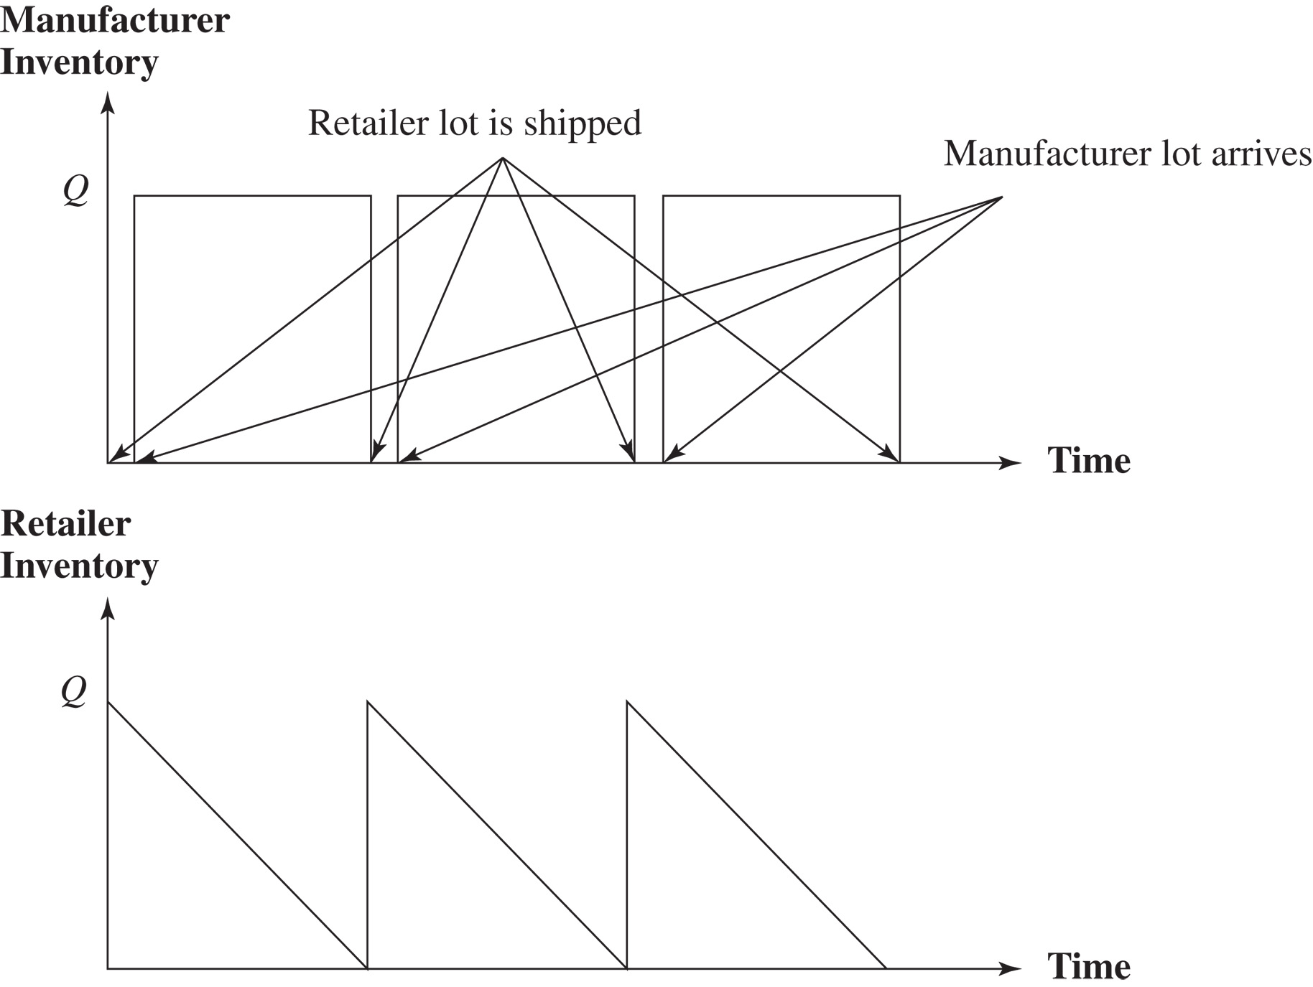
Managing Multiechelon Cycle Inventory
Figure 11-6

Slide 97
Multiechelon lot sizing
The replenishment process of one inventory system affects the demand process of another.
Q_{M}
Manf. Inventory
time
Retailer Inventory
Q_{R}
time
Dotted, sloped line above primary inventory indicates depletion of primary item echelon stock.

Slide 98
K echelon stock
Number of items that are currently residing at echelon K or
have passed through it and are currently residing at a
“higher” echelon in a multiechelon inventory system.
360 bolts in 40 subassemblies
200 bolts in 20 products
1560 bolts in echelon inventory
1000 bolts
Parts inventory
Subassembly inv.
Final inv.

Slide 99
Multiechelon lot sizing
Note: K must be integer
otherwise; residual inventory results having no purpose at predecessor level.
Wasted inventory cost
K = 2.5

Slide 100
Multiechelon lot sizing
Example:
j | I_{j} | E_{j}
1 | 10 | 10
2 | 30 | 40
3 | 20 | 60
4 | 50 | 110

Slide 101
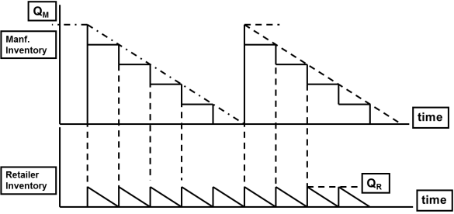
Multiechelon lot sizing
e_{j} = echelon holding cost at j
echelon stock version of TC(K):
“value added” at echelon j
s.t.

Slide 102
Multiechelon lot sizing
A simple serial system with constant demand
2
1
Example
item 1 is produced from one unit of the component 2.
D = 8, S₁ = 20, S₂ = 80, H₁ = 5, H₂ = 4.

Slide 103
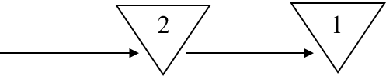
Multiechelon lot sizing
Treat the two installations independently
where k is a positive integer.

Slide 104
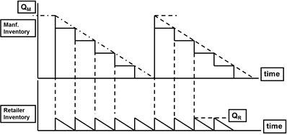
Multiechelon lot sizing
If k* < 1 it is optimal to choose k = 1.
If k* > 1. Let k´ be the largest integer less or equal to k*
k´ ≤ k* < k´ + 1, it is optimal to choose k = k´
if k*/k´ ≤ (k´ + 1)/k*, otherwise k = k´+ 1.
k* ≈ 2.24, k = 2. C₂ = 56, C = C₁ + C₂ = 40 + 56 = 96.

Slide 105
Multiechelon lot sizing
2
1
Treat the two installations together
Alternatively, use the echelon holding costs e₁ = H₁ - H₂,
and e₂ = H₂,
The two cost expressions are equivalent

Slide 106
Multiechelon lot sizing
If k* < 1 it is optimal to choose k = 1.
If k* > 1. Let k´ be the largest integer less or equal to k*
k´ ≤ k* < k´ + 1, it is optimal to choose k = k´
if k*/k´ ≤ (k´ + 1)/k*, otherwise k = k´+ 1.

Slide 107
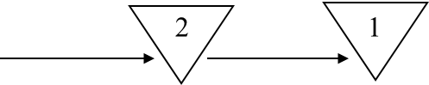
Multiechelon lot sizing
Example
D = 8, S₁ = 20, S₂ = 80, H₁ = 5, H₂ = 4.
e₁ = H₁ - H₂ = 1, e₂ = H₂ = 4.
k* = 1.
and C* ≈ 89.44, about 7 percent lower than the costs obtained
when treating the stages independently
Note, the Q* and Cost equation are essentially equivalent to the
corresponding expressions for the classical economic order quantity model.
= S₁ + S₂/k ,
= e₁ + ke₂.

Slide 108
Tailored Network: Multi-Echelon Finished Goods Network
Local DC
Cross-Dock
Store 1
Regional
Finished
Goods DC
Customer 1
DC
Store 2
Local DC
Cross-Dock
National
Finished
Goods DC
Store 3
Customer 2
DC
Local DC
Cross-Dock
Store 4
Regional
Finished
Goods DC
Store 5
Store 6
Notes:
Notes:

Slide 109
Integer Replenishment Policy
Integer replenishment policies can be synchronized in multiechelon supply chains to keep cycle inventory and order costs low.
Under such policies, the reorder interval at any stage is an integer multiple of a base reorder interval.
Synchronized integer replenishment policies facilitate a high level of cross-docking across the supply chain.

Slide 110
Integer Replenishment Policy
Divide all parties within a stage into groups such that all parties within a group order from the same supplier and have the same reorder interval
Set reorder intervals across stages such that the receipt of a replenishment order at any stage is synchronized with the shipment of a replenishment order to at least one of its customers
For customers with a longer reorder interval than the supplier,
make the customer’s reorder interval an integer multiple of the supplier’s interval and
synchronize replenishment at the two stages to facilitate cross-docking

Slide 111
Integer Replenishment Policy
For customers with a shorter reorder interval than the supplier,
make the supplier’s reorder interval an integer multiple of the customer’s interval and
synchronize replenishment at the two stages to facilitate cross-docking
The relative frequency of reordering depends on the setup cost, holding cost, and demand for the different parties
These polices make the most sense for supply chains in which cycle inventories are large and demand is relatively predictable

Slide 112
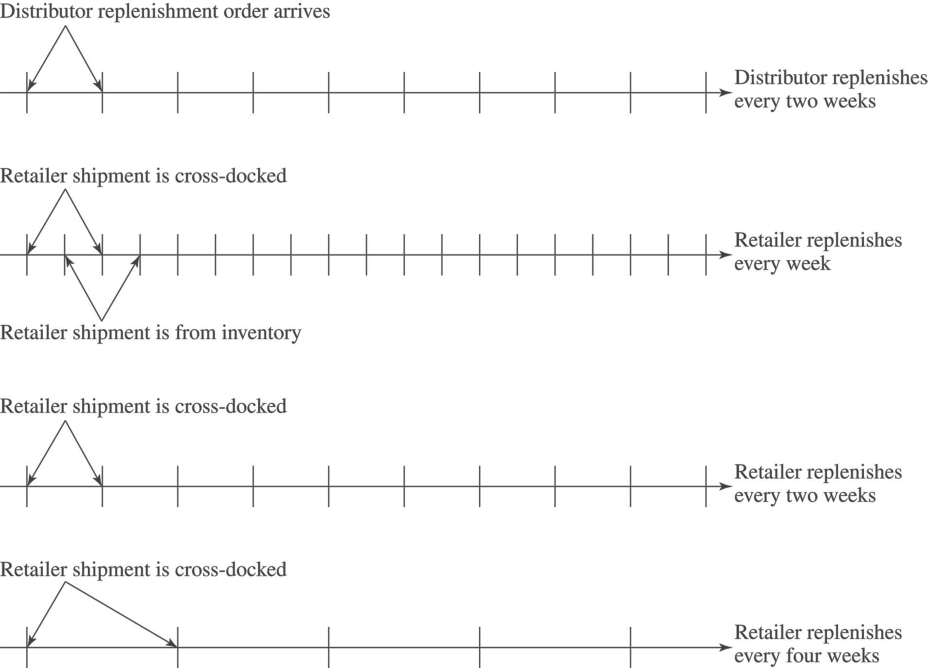
Integer Replenishment Policy
Figure 11-7

Slide 113
Integer Replenishment Policy
Figure 11-8

Slide 114
Multiechelon lot sizing
Nonlinear Programming Problem
, i = 1, 2, ..., N.

Slide 115
Multiechelon lot sizing
The resulting solution of the following Lagrangian Relaxation will give a lower bound for the costs.
where λ_{i} are nonnegative.
The optimal solution of the relaxed problem can be obtained by solving N + 1 independent classical lot sizing problems without any constraints on the cycle times.
Rounding the cycle times of the relaxed problem,
Power-of-2 “synchronization”

Slide 116
Multiechelon lot sizing
Powers-of-two policies
Cycle times are restricted to be powers of two times a certain basic period denoted as q .
The ratio of the cost of an arbitrary order quantity to the optimal EOQ = Q* is given by
Let T = Q/D, T* = Q*/D

Slide 117
Multiechelon lot sizing
Worst case scenario:
Because the cost is convex, the worst possible error must occur when two consecutive values of m, say m = k and m = k + 1 give the same error. Let T < T * correspond to m = k, and 2T > T * to m = k + 1.

Slide 118
Power-of-2 Distribution System Lot Sizing
Distribution Network
shipments to warehouse lead to shipments to retailers
D_{i} = demand at retailer i
lot sizing decisions must satisfy “zero-ordering” policy
for modeling purposes, inventory at the warehouse is broken into i categories… inventory is “tagged” for retailer i
0
Warehouse
1
2
3
Retailers

Slide 119
Power-of-2 Distribution System Lot Sizing
Echelon inventory holding cost structure
warehouse echelon cost
retailer i echelon cost

Slide 120
Power-of-2 Distribution System Lot Sizing
Case 1 : T_{i} ≥ T₀
order at warehouse placed every time order placed at retailer i
no inventory for retailer i held at warehouse… cross-docking
Q_{i}
Q_{i}
Q_{i}
Q_{i} = D_{i}T_{i}
T₀
T₀
T₀
T₀
Warehouse
T_{i}
T_{i}
Retailer i

Slide 121
Power-of-2 Distribution System Lot Sizing
Case 2 : T_{i} < T₀
periodic cross-docking of retailer i order at warehouse
Q_{i}
Q_{i} = D_{i}T_{i}
Q_{i}
Warehouse
T₀
T₀
Q_{i}
T_{i}
T_{i}
T_{i}
T_{i}
Retailer i

Slide 122
Power-of-2 Distribution System Lot Sizing
Expected cost of Power-of-2 policy

Slide 123
Solution Algorithm

Slide 124
Power-of-2 Distribution System Lot Sizing
Round-off to Power-of-2 intervals

Slide 125
Power-of-2 Distribution System Lot Sizing
Example
q = 1 week = 1 / 52 year = .0192 year
 | R₁ | R₂ | R₃ | WH
D_{i} | 10000 | 1000 | 100
S_{i} | 50 | 90 | 120 | 70
H_{i} | 4 | 5 | 6 | 3
e_{i} | 1 | 2 | 3 | 3
g_{i} | 5000 | 1000 | 150 | (.5e_{i}D_{i})
g^{i} | 15000 | 1500 | 150 | (.5e₀D_{i})

Slide 126
Power-of-2 Distribution System Lot Sizing
Step1
compute conventional and echelon cycles
form ordered set, T, of cycle times
T = {.05, .1, .19, .3, .632, .894}
T = { t₁’ , t₁ , t₂’ , t₂ , t₃’ , t₃ }
Step 2
E = G = Φ , L = {1, 2, 3} , S = 70 , H = 16650
 | R₁ | R₂ | R₃
t_{i}’=[S_{i} / (g_{i}+g^{i})]^{1/2} | [50/20000]^{1/2} =.05 | [90/2500]^{1/2} =.19 | [120/300]^{1/2} =.632
t_{i}=[S_{i} / g_{i}]^{1/2} | [50/5000]^{1/2} =.1 | [90/1000]^{1/2} =.3 | [120/150]^{1/2} =.894

Slide 127
Power-of-2 Distribution System Lot Sizing
Step 3
Step 4
T₀* = T₁* = .078
T₂* = t₂’ = .19 T₃* = t₃’ =.632
t* | [S/H]^{1/2} | cycle test | E | L | G | S | H | delete from T
.894 | .065 | ech. | {3} | {1,2} | Φ | 190 | 16800 | t₃
.632 | .106 | conv. | Φ | {1,2} | {3} | 70 | 16500 | t₃’
.3 | .065 | ech. | {2} | {1} | {3} | 160 | 17500 | t₂
.19 | .096 | conv. | Φ | {1} | {2,3} | 70 | 15000 | t₂’
.1 | .068 | ech. | {1} | Φ | {2,3} | 120 | 20000 | t₁
.05 | .078 | STOP

Slide 128
Power-of-2 Distribution System Lot Sizing
Power-of-2 Round-off

